Slide 1




NEXT GEN EMPLOYABILITY PROGRAM
Creating a future-ready workforce
Team Members
College Name
Student Name :Safrina S
Student ID : au960221104098
Arunachala College of Engineering for Women

Slide 2

CAPSTONE PROJECT SHOWCASE
Project Title
Car Rentals Application with Django Framework
Abstract | Problem Statement | Project Overview | Proposed Solution | Technology Used | Modelling & Results | Conclusion

Slide 3
Abstract
The car rentals application developed using the Django framework presents a comprehensive solution for individuals seeking to rent vehicles with ease and efficiency. Through the utilization of Django's powerful capabilities, the application boasts a robust backend system that facilitates seamless user registration, authentication, and booking management. Users can effortlessly browse through a diverse selection of available vehicles, filtering options based on their preferences, and securely complete transactions using integrated payment processing functionalities.
Source :

Slide 4
Problem Statement
The problem statement for a car rentals application developed using the Django framework outlines the specific challenges or inefficiencies within the car rental industry that the application aims to address. Here's an example problem statement:
The car rental industry faces numerous challenges related to accessibility, convenience, and transparency, which hinder the overall rental experience for both customers and rental agencies. Traditional rental processes often involve cumbersome paperwork, limited vehicle options, and unclear pricing structures, leading to frustration and dissatisfaction among users. Additionally, manual management of vehicle fleets and bookings can result in inefficiencies and errors for rental agencies, impacting their ability to provide timely and reliable service.
Source :

Slide 5
Project Overview
The car rentals application, developed using the Django framework, offers a comprehensive solution to the complexities often associated with renting vehicles. By leveraging Django's powerful features, the application provides users with a seamless experience from start to finish. Users can effortlessly navigate through a diverse selection of vehicles, filtering options based on their preferences and requirements. The intuitive booking system allows users to easily select pickup and drop-off locations, choose rental dates, and complete transactions securely through integrated payment processing. Additionally, the application offers a centralized admin dashboard for rental agencies, empowering them to efficiently manage their vehicle inventory, track bookings, and generate insightful reports for analysis.
Source :

Slide 6
Proposed Solution
.
To tackle the complexities inherent in the car rental industry, our proposed solution revolves around the development of a robust car rentals application using the Django framework. This solution aims to revolutionize the rental experience for both users and rental agencies by addressing key pain points and streamlining operations. By implementing a user-friendly interface with intuitive navigation, users can effortlessly browse through a diverse selection of vehicles, select their preferred options, and complete bookings seamlessly.
Source :

Slide 7
Additionally, transparent pricing structures and clear terms of service will ensure users have a clear understanding of the costs associated with their rental, fostering trust and confidence in the platform. For rental agencies, the application will offer advanced administrative tools, including a centralized dashboard for managing vehicle inventory, tracking bookings, and generating insightful reports.
Source :

Slide 8
By leveraging Django's robust security features, we will prioritize the protection of user data and payment information, ensuring a safe and secure rental experience for all parties involved. Overall, our proposed solution aims to set a new standard for car rentals, offering a modern, efficient, and user-centric platform that enhances the rental experience for everyone involved.
Source :

Slide 9

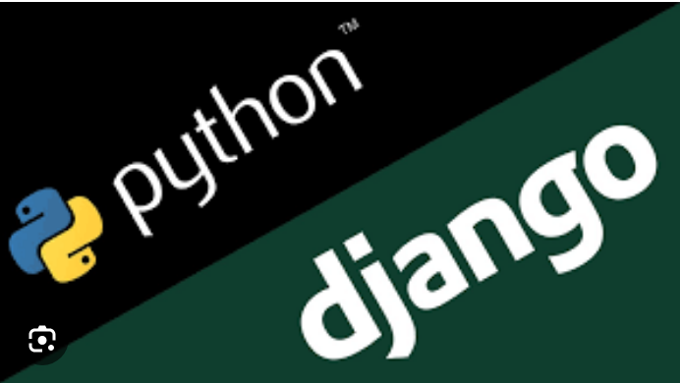
Technology Used
Front-end
Back-end
Source :

Slide 10
Modelling & Results
To provide a comprehensive modeling and results analysis for a car rental application built with the Django framework, we can break down the process into several key components:
Database Modeling
User Authentication and Authorization
Car Inventory Management
Booking and Rental Workflow
Payment Processing
Location Services and Mapping
Reporting and Analytics
Performance Optimization
Deployment and Scalability
Results analysis would involve evaluating the application's performance, usability, and effectiveness in meeting business goals. Key metrics to consider include user engagement (e.g., number of bookings, repeat customers), revenue generation, customer satisfaction ratings, and operational efficiency.
Source :

Slide 11
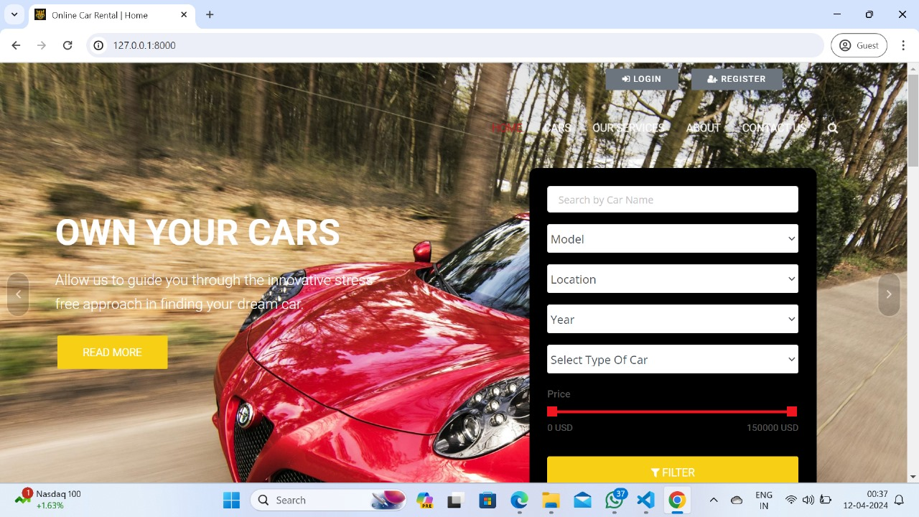
Homepage

Slide 12
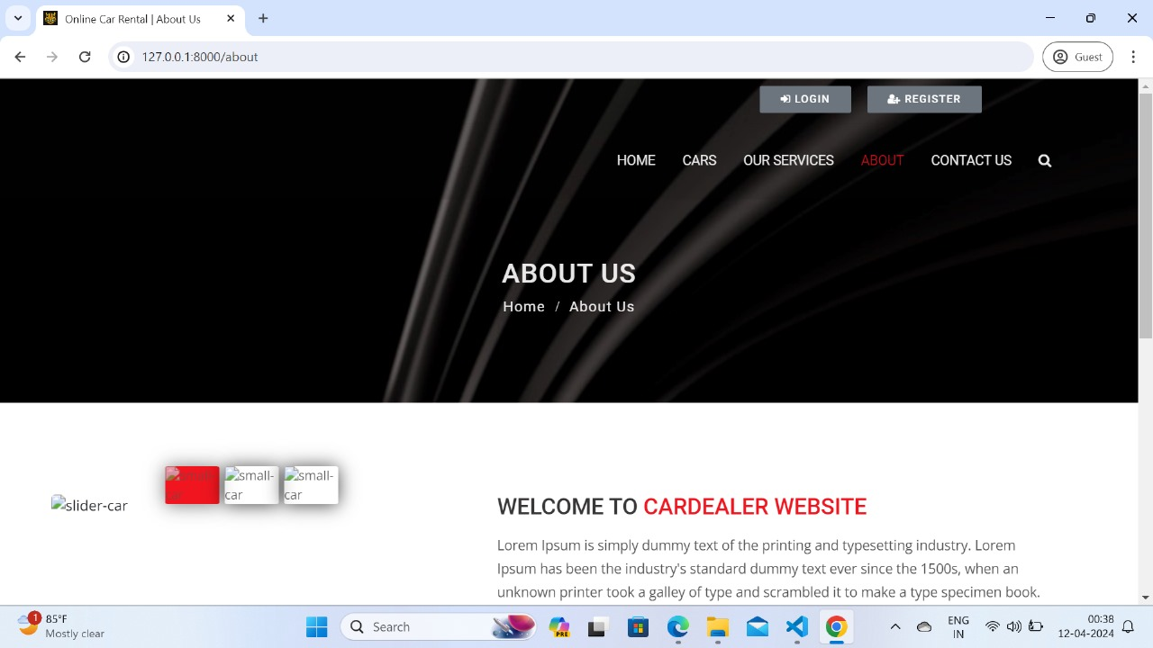
About-Us-Page

Slide 13
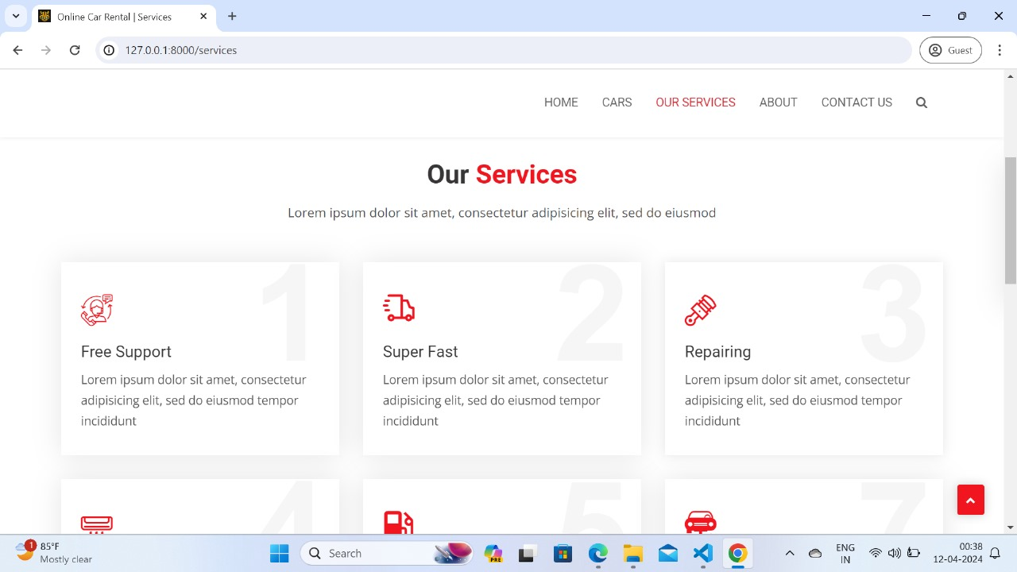
Service-Page

Slide 14
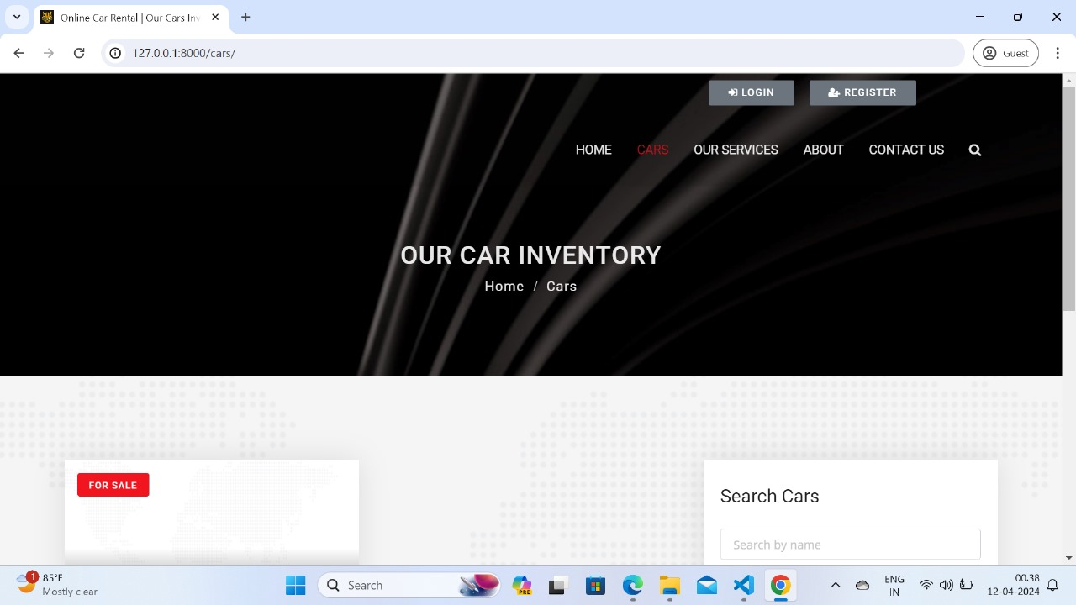
Departments-Page

Slide 15
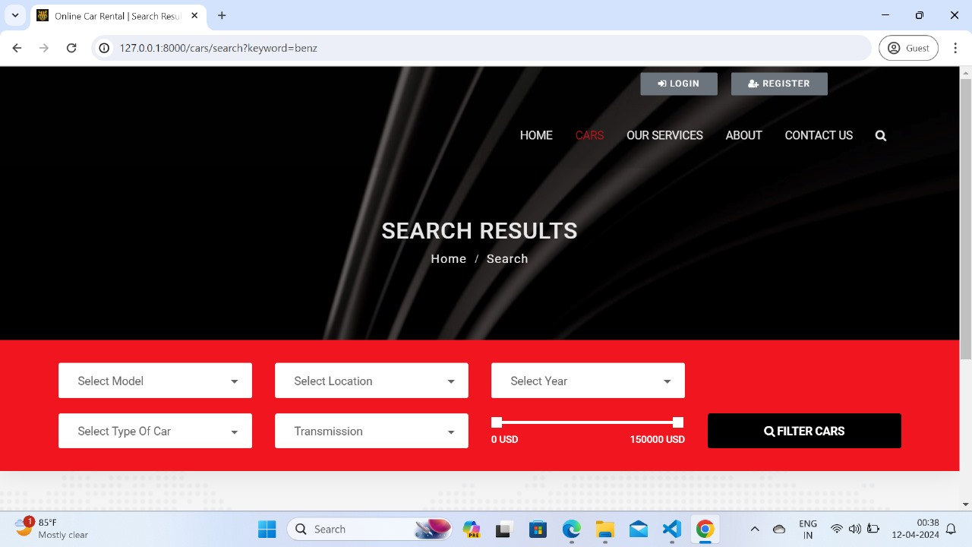
Blog-Page

Slide 16
Future Enhancements:
Here are some potential future enhancements for a car rental application built using the Django framework:
User Profiles
Advanced Search Filters
Rating and Reviews
Integration with Maps and GPS
Multi-Language Support
Dynamic Pricing
Insurance Options
Fleet Management
Promotions and Discounts:
Mobile App
Integration with Payment Gateways
Customer Support Chatbot.
These enhancements can improve the functionality, user experience, and competitiveness of the car rental application in the market.

Slide 17
Conclusion
In conclusion, building a car rental application using the Django framework offers numerous advantages in terms of scalability, security, and flexibility. With Django's robust features and built-in functionalities, developers can create a powerful platform capable of handling various aspects of the car rental process efficiently.
Throughout this exploration, we've discussed the key components and features that can be implemented in a Django-based car rental application, including user authentication, booking management, inventory tracking, payment processing, and more. By leveraging Django's MVC architecture, ORM capabilities, and extensive library of third-party packages, developers can streamline the development process and deliver a high-quality application that meets the needs of both rental companies and customers.
Source :

Slide 18
Thank You!
Notes:
Thank You !!

